Slide 1


UNIT 3
Memory Management
Course Learning Rationale
Emphasize the importance of Memory Management concepts of an Operating system
Course Learning Outcomes
Understand the need of Memory Management functions of an Operating system

Slide 2
Topics
1 | MEMORY MANAGEMENT: Memory Management: Logical Vs Physical address space, Swapping
 | Understanding the basics of Memory management
2 | Contiguous Memory allocation – Fixed and Dynamic partition
 | Getting to know about Partition memory management and issues: Internal fragmentation and external fragmentation problems
3 | Strategies for selecting free holes in Dynamic partition
 | Understanding the allocation strategies with examples
4 | Paged memory management
 | Understanding the Paging technique.PMT hardware mechanism
5 | Structure of Page Map Table
 | Understanding the components of PMT
6 | Example : Intel 32 bit and 64 –bit Architectures
 | Understanding the Paging in the Intel architectures
7 | Example : ARM Architectures
 | Understanding the Paging with respect to ARM
8 | Segmented memory management
 | Understanding the users view of memory with respect to the primary memory
9 29-03-2021 | Paged segmentation Technique
 | Understanding the combined scheme 1fo8Cr SeCf2fi0c5iJeOnpt emraatninaggSeymsteenmts- Memory Management
2

Slide 3
Basics of Memory Management

Slide 4
Memory : Basics
Memory is central part for the operation of a modern computer system
Memory consists of a large array of words or bytes, each with its own address.
The CPU fetches instructions from memory according to the value of the program counter which may need additional loading from and storing to specific memory addresses.
A typical instruction-execution cycle, first fetches an instruction from memory. The instruction is then decoded and may cause operands to be fetched from memory.
After the instruction has been executed on the operands, results may be stored back in memory.
Courtesy : Abraham Silberschatz, Peter
Baer Galvin, Greg Gagne, Operating systems, 9th ed., John Wiley & Sons, 2013
18CSC205J Operating Systems- Memory Management
4

Slide 5
Memory : Basics (Cont.)
The memory unit sees only a
Stream of memory addresses;
It does not know how they are generated (by the instruction counter, indexing, indirection, literal addresses, and so on) or
What they are for (instructions or data).
Hence we can ignore how a program generates a memory address.
We are interested only in the sequence of memory addresses generated by the running program.
Courtesy : Abraham Silberschatz, Peter
Baer Galvin, Greg Gagne, Operating systems, 9th ed., John Wiley & Sons, 2013
18CSC205J Operating Systems- Memory Management
4

Slide 6
Basic Hardware
Program must be brought (from disk) into memory and placed within a process for it to be run
Main memory and registers are only storage CPU can access directly
Memory unit only sees a stream of addresses + read requests, or address + data and write requests
Register access in one CPU clock (or less)
Main memory can take many cycles, causing a stall Cache sits between main memory and CPU registers
Protection of memory required to ensure correct operation
Courtesy : Abraham Silberschatz, Peter
Baer Galvin, Greg Gagne, Operating systems, 9th ed., John Wiley & Sons, 2013
18CSC205J Operating Systems- Memory Management
4

Slide 7
A Base and a Limit Register
Each process should have a separate memory space.
To do this, we need the ability to determine the range of legal addresses that the process may access and to ensure that the process can access only these legal addresses.
Operating system provide this protection by using two registers:
a base and
a limit
The base register holds the smallest legal physical memory address
The limit register specifies the size of the range
Courtesy : Abraham Silberschatz, Peter
Baer Galvin, Greg Gagne, Operating systems, 9th ed., John Wiley & Sons, 2013
18CSC205J Operating Systems- Memory Management
4

Slide 8
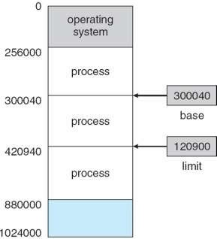
A Base and a Limit Register
For example, if the base register holds 300040 and
The limit register is 120900, then the program can legally access all addresses from 300040 through 420939 (inclusive).
Courtesy : Abraham Silberschatz, Peter Baer Galvin, Greg Gagne, Operating systems, 9th ed., John Wiley & Sons, 2013
18CSC205J Operating Systems- Memory Management
8

Slide 9

Hardware Address Protection
Courtesy : Abraham Silberschatz, Peter
Baer Galvin, Greg Gagne, Operating systems, 9th ed., John Wiley & Sons, 2013
18CSC205J Operating Systems- Memory Management
10

Slide 10
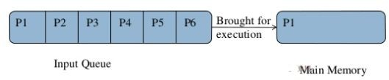
Address Binding
Usually, a program resides on a disk as a binary executable file.
The program to be executed must be brought into memory and placed within a process.
Depending on the memory management in use, the process may be moved between disk and memory during its execution.
The processes on the disk that are waiting to be brought into memory for execution form the input queue.
Courtesy : Abraham Silberschatz, Peter
Baer Galvin, Greg Gagne, Operating systems, 9th ed., John Wiley & Sons, 2013
18CSC205J Operating Systems- Memory Management
10

Slide 11

Address Binding
Addresses may be represented in different ways during the execution of the program
Addresses in the source program are generally symbolic (such as
count)
A compiler will typically bind these symbolic addresses to relocatable addresses (such as “14 bytes from the beginning of this module”)
The linkage editor or loader will in turn bind the relocatable addresses to absolute addresses (such as 74014)
Each binding is a mapping
from one address space to another.
Courtesy : Abraham Silberschatz, Peter
Baer Galvin, Greg Gagne, Operating systems, 9th ed., John Wiley & Sons, 2013
18CSC205J Operating Systems- Memory Management
10

Slide 12
Binding of Instructions and Data to Memory
Address binding of instructions and data to memory addresses can happen at three different stages
– Compile time: If memory location known a priori, absolute
recompile code if starting location changes
code can be generated; must
Load time: Must generate relocatable code if memory location is not known at compile time
Execution time: Binding delayed until run time if the process can be moved during its execution from one memory segment to another
Need hardware support for address maps (e.g., base and limit registers)
Courtesy : Abraham Silberschatz, Peter
Baer Galvin, Greg Gagne, Operating systems, 9th ed., John Wiley & Sons, 2013
18CSC205J Operating Systems- Memory Management
10

Slide 13
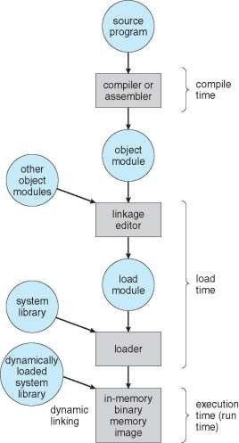
Multistep Processing of a User Program
Courtesy : Abraham Silberschatz, Peter Baer Galvin, Greg Gagne, Operating systems, 9th ed., John Wiley & Sons, 2013
13
18CSC205J Operating Systems- Memory Management

Slide 14
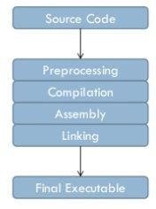
Program Execution
29-03-2021
18CSC205J Operating Systems- Memory Management

Slide 15
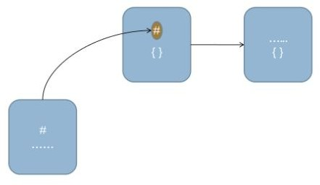
Compilation
Compiled code
Source Code
29-03-2021
18CSC205J Operating Systems- Memory Management

Slide 16
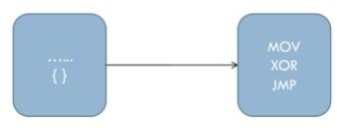
Assembler
Assembly Code
29-03-2021
18CSC205J Operating Systems- Memory Management

Slide 17

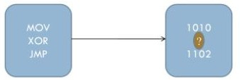
29-03-2021
18CSC205J Operating Systems- Memory Management

Slide 18
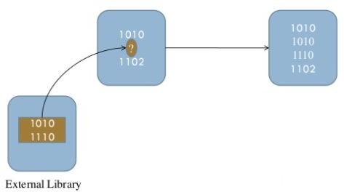
Linker/Loader
Machine Code
29-03-2021
18CSC205J Operating Systems- Memory Management

Slide 19

Logical vs Physical Address Space
An address generated by the CPU is commonly referred to as a logical address
An address seen by the memory unit—that is, the one loaded into the memory-address register of the memory—is commonly referred to as a physical address.
The compile-time and load-time address-binding methods generate identical logical and physical addresses.
However, the execution-time address binding scheme results in differing logical and physical addresses.
Courtesy : Abraham Silberschatz, Peter Baer Galvin, Greg Gagne, Operating
systems, 9th ed., John Wiley & Sons, 2013
18CSC205J Operating Systems- Memory Management
19

Slide 20
Logical vs Physical Address Space (Cont.)
In this case, we usually refer to the logical address as a virtual address.
The set of all logical addresses generated by a program is a logical address space;
The set of all physical addresses corresponding to these logical addresses is a
physical address space.
The run-time mapping from virtual to physical addresses is done by a hardware device called the memory-management unit (MMU).
Courtesy : Abraham Silberschatz, Peter
₂₉Ba₋₀er₃G₋a₂lv₀in₂, G₁reg Gagne, Operating
systems, 9th ed., John Wiley & Sons, 2013
18CSC205J Operating Systems- Memory Management
20

Slide 21
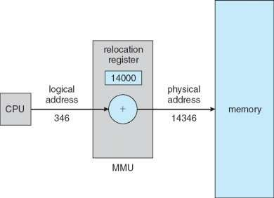
Dynamic Relocation using a Relocation Register
The base register is now called a
Relocation Register.
The value in the relocation register is added to every address generated by a user process at the time the address is sent to memory.
For example, if the base is at 14000, then an attempt by the user to address location 0 is dynamically relocated to location 14000;
an access to location 346 is mapped to location 14346.
Courtesy : Abraham Silberschatz, Peter
Baer Galvin, Greg Gagne, Operating systems, 9th ed., John Wiley & Sons, 2013
18CSC205J Operating Systems- Memory Management

Slide 22
Logical vs Physical Address Space (Cont.)
The two different types of addresses:
logical addresses (in the range 0 to max) and
physical addresses (in the range R + 0 to R + max for a base value
R)
The user generates only logical addresses and thinks that the process runs in locations 0 to max.
The user program generates only logical addresses and thinks that the process runs in locations 0 to max.
However, these logical addresses must be mapped to physical addresses before they are used.
Courtesy : Abraham Silberschatz, Peter
Baer Galvin, Greg Gagne, Operating systems, 9th ed., John Wiley & Sons, 2013
18CSC205J Operating Systems- Memory Management

Slide 23
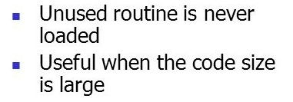
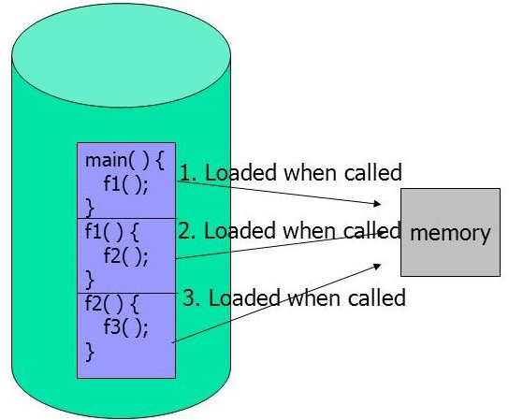
Dynamic Loading

Slide 24
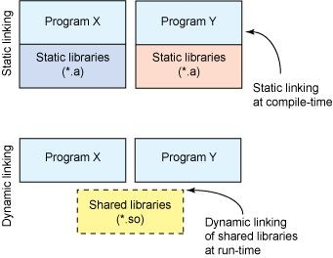
Dynamic linking
Static linking
System libraries and program code seperately
Some OS support only static linking
Dynamic linking
Linking is postponed until execution time
Wastage of both disk space and main memory is avoided

Slide 25
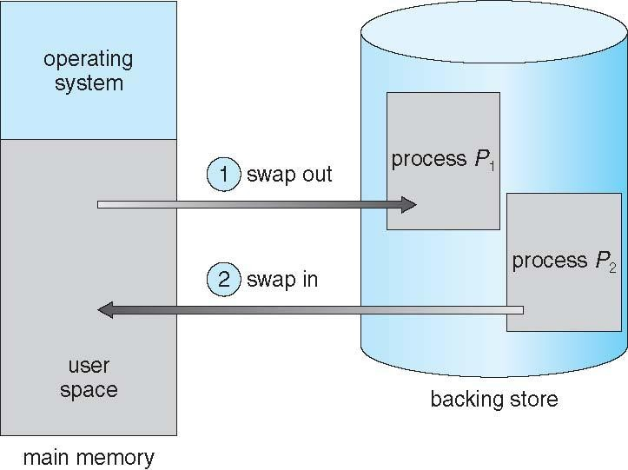
Swapping
A process can be swapped temporarily out of memory to a backing store, and then brought back into memory for continued execution
Total physical memory space of processes can exceed physical memory
This increases the degree of multiprogramming in a system
Backing store – Normally its hard disk

Slide 26
CONTIGUOUS MEMORY ALLOCATION
29-03-2021
18CSC205J Operating Systems- Memory Management

Slide 27
Contiguous Allocation
The main memory must accommodate both the operating system and the various user processes.
The memory is usually divided into two partitions:
one for the resident operating system
one for the user processes.
29-03-2021
18CSC205J Operating Systems- Memory Management

Slide 28
Contiguous Allocation (Cont.)
Several user processes want to reside in memory at the same time.
Then it is to be considered, how to allocate available memory to the processes that are in the input queue waiting to be brought into memory.
In contiguous memory allocation, each process is contained in a single section of memory that is contiguous to the section containing the next process.
29-03-2021
18CSC205J Operating Systems- Memory Management

Slide 29
Contiguous Allocation (Cont.)
The relocation register contains the value of the smallest physical address;
The limit register contains the range of logical addresses (for example, relocation = 100040 and limit = 74600).
Each logical address must fall within the range specified by the limit register.
The MMU maps the logical address dynamically by adding the value in the relocation register.
29-03-2021
18CSC205J Operating Systems- Memory Management

Slide 30
Contiguous Allocation (Cont.)
This mapped address is sent to memory. When the CPU scheduler selects a process for execution, the dispatcher loads the relocation and limit registers with the correct values as part of the context switch.
Because every address generated by a CPU is checked against these registers, we can protect both the operating system and the other users programs and data from being modified by this running process.
29-03-2021
18CSC205J Operating Systems- Memory Management

Slide 31
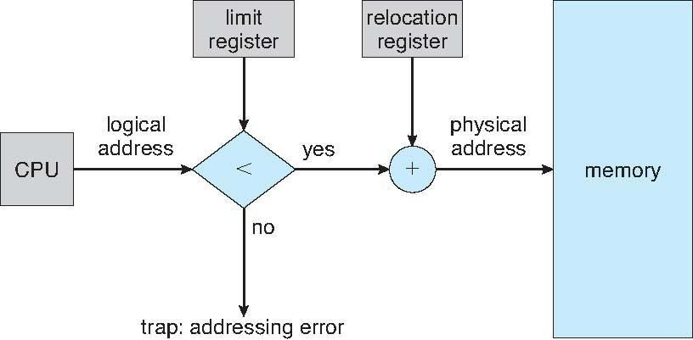
Hardware Support for Relocation and Limit Registers
29-03-2021
18CSC205J Operating Systems- Memory Management

Slide 32
Contiguous Allocation (Cont.)
The relocation-register scheme provides an effective way to allow the operating system’s size to change dynamically. This flexibility is desirable in many situations.
For example, the operating system contains code and buffer space for device drivers.
29-03-2021
18CSC205J Operating Systems- Memory Management

Slide 33
Contiguous Allocation (Cont.)
If a device driver (or other operating-system service) is not commonly used, we do not want to keep the code and data in memory, as we might be able to use that space for other purposes.
Such code is sometimes called transient operating-system code; it comes and goes as needed. Thus, using this code changes the size of the operating system during program execution.
29-03-2021
18CSC205J Operating Systems- Memory Management

Slide 34
Contiguous Allocation Technique
There are two popular techniques used for contiguous memory allocation
Fixed Partitioning
Variable Partitioning
29-03-2021
18CSC205J Operating Systems- Memory Management

Slide 35
Fixed Partitioning
Static partitioning is a fixed partitioning scheme.
In this partitioning, number of partitions (non-overlapping) in RAM are
fixed but size of each partition may or may not be same.
As it is contiguous allocation, hence no spanning is allowed.
Here partition are made before execution or during system configure.
Each partition is allowed to store only one process.
These partitions are allocated to the processes as they arrive.
29-03-2021
18CSC205J Operating Systems- Memory Management

Slide 36
Fixed Partitioning (Cont.)
The degree of multiprogramming is bound by the number of partitions.
In this multiple partition method, when a partition is free, a process is selected from the input queue and is loaded into the free partition.
When the process terminates, the partition becomes available for another process.
29-03-2021
18CSC205J Operating Systems- Memory Management

Slide 37
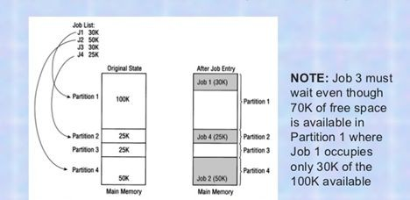
Fixed Partitioning (Cont.)
Example
29-03-2021
18CSC205J Operating Systems- Memory Management

Slide 38
Disadvantages of Fixed Partitioning
Limitation on the Size of the Process: – Sometimes, when the size of the process is larger than the maximum partition size, then we cannot load that process into the memory. So, this is the main disadvantage of the fixed partition.
Degree of Multiprogramming is Less: – We can understand from the degree of multiprogramming that it means at the same time, the maximum number of processes we can load into the memory. In Fixed Partitioning, the size of the partition is fixed, and we cannot vary it according to the process size; therefore, in fixed partitioning, the degree of multiprogramming is less and fixed.
Internal Fragmentation
Let us first discuss about what is fragmentation and then discuss about Internal Fragmentation
29-03-2021
18CSC205J Operating Systems- Memory Management

Slide 39
Fragmentation
Fragmentation is an unwanted problem where the memory blocks cannot be allocated to the processes due to their small size and the blocks remain unused.
It can also be understood as when the processes are loaded and removed from the memory they create free space or hole in the memory and these small blocks cannot be allocated to new upcoming processes and results in inefficient use of memory.
Basically, there are two types of fragmentation:
Internal Fragmentation
External Fragmentation
29-03-2021
18CSC205J Operating Systems- Memory Management

Slide 40
Internal Fragmentation
It occurs when the space is left inside the partition after allocating the partition to a process.
This space is called as internally fragmented space.
This space can not be allocated to any other process.
This is because only Fixed (static) partitioning allows to store only one process in each partition.
Internal Fragmentation occurs only in Fixed (static) partitioning .
29-03-2021
18CSC205J Operating Systems- Memory Management

Slide 41
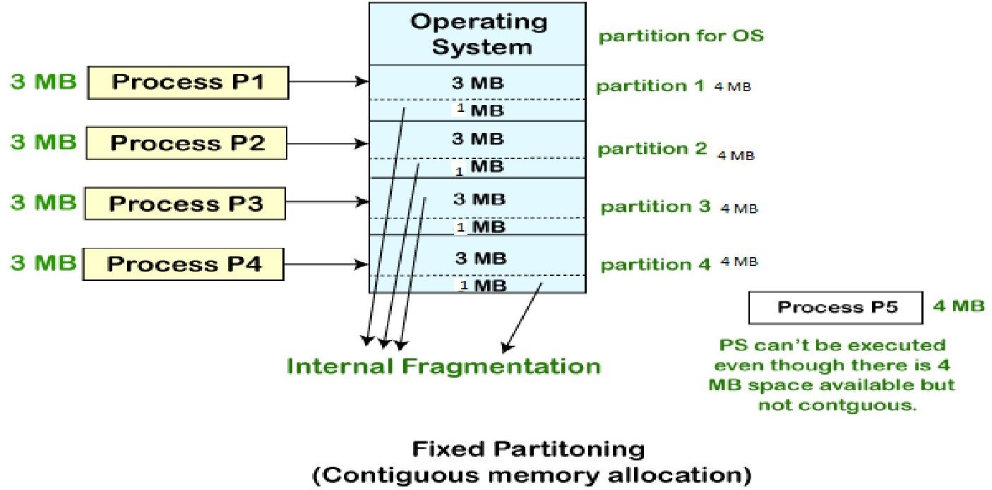
Internal Fragmentation (Cont.)
29-03-2021
18CSC205J Operating Systems- Memory Management

Slide 42
Solution to Internal Fragmentation
This problem is occurring because we have fixed the sizes of the memory blocks. This problem can be removed if we use dynamic partitioning for allocating space to the process.
In dynamic partitioning, the process is allocated only that much amount of space which is required by the process. So, there is no internal fragmentation.
29-03-2021
18CSC205J Operating Systems- Memory Management

Slide 43
Variable - Partitioning
In the variable-partition scheme, the operating system keeps a table indicating which parts of memory are available and which are occupied.
Initially, all memory is available for user processes and is considered one large block of available memory, a hole.
Eventually, memory contains a set of holes of various sizes.
As processes enter the system, they are put into an input queue.
29-03-2021
18CSC205J Operating Systems- Memory Management

Slide 44
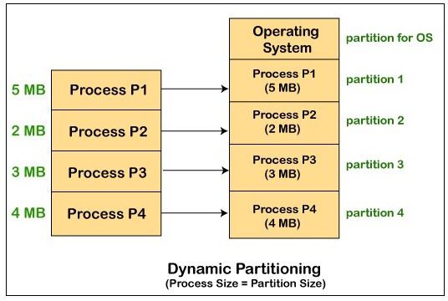
Variable – Partitioning (Cont.)
29-03-2021
18CSC205J Operating Systems- Memory Management

Slide 45
Variable – Partitioning (Cont.)
The operating system takes into account the memory requirements of each process and the amount of available memory space in determining which processes are allocated memory.
When a process is allocated space, it is loaded into memory, and it can then compete for CPU time.
When a process terminates, it releases its memory, which the operating system may then fill with another process from the input queue.
29-03-2021
18CSC205J Operating Systems- Memory Management

Slide 46
Variable – Partitioning (Cont.)
At any given time, then, we have a list of available block sizes and an input queue. The operating system can order the input queue according to a scheduling algorithm. Memory is allocated to processes until, finally, the memory requirements of the next process cannot be satisfied — that is, no available block of memory (or hole) is large enough to hold that process.
29-03-2021
18CSC205J Operating Systems- Memory Management

Slide 47
Variable – Partitioning (Cont.)
The operating system can then wait until a large enough block is available, or it can skip down the input queue to see whether the smaller memory requirements of some other process can be met.
In general, as mentioned, the memory blocks available comprise a set of holes of various sizes scattered throughout memory. When a process arrives and needs memory, the system searches the set for a hole that is large enough for this process.
29-03-2021
18CSC205J Operating Systems- Memory Management

Slide 48
Variable – Partitioning (Cont.)
If the hole is too large, it is split into two parts. One part is allocated to the arriving process; the other is returned to the set of holes.
When a process terminates, it releases its block of memory, which is then placed back in the set of holes.
If the new hole is adjacent to other holes, these adjacent holes are merged to form one larger hole.
At this point, the system may need to check whether there are processes waiting for memory and whether this newly freed and recombined memory could satisfy the demands of any of these waiting processes.
29-03-2021
18CSC205J Operating Systems- Memory Management

Slide 49
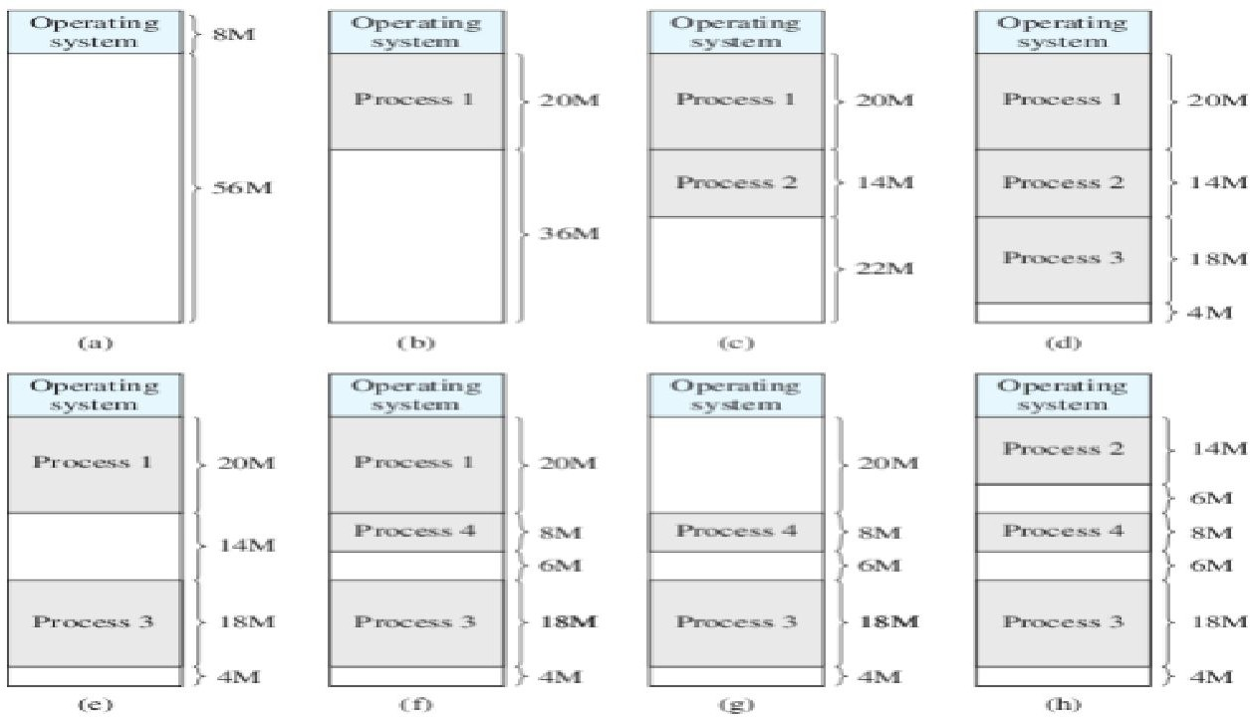
Variable – Partitioning (Cont.)
29-03-2021
18CSC205J Operating Systems- Memory Management

Slide 50
Variable – Partitioning (Cont.)
This procedure is a particular instance of the general dynamic storage-allocation problem, which concerns how to satisfy a request of size n from a list of free holes.
There are many solutions to this problem. The first-fit, best-fit, and worst-fit strategies are the ones most commonly used to select a free hole from the set of available holes.
29-03-2021
18CSC205J Operating Systems- Memory Management

Slide 51
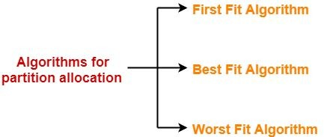
Partition Allocation Algorithm
29-03-2021
18CSC205J Operating Systems- Memory Management

Slide 52
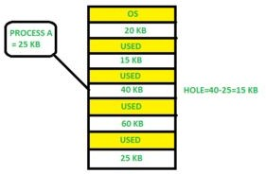
First Fit
Allocate the first hole that is big enough.
Searching can start either at the beginning of the set of holes or at the location where the previous first-fit search ended.
We can stop searching as soon as we find a free hole that is large enough.
29-03-2021
18CSC205J Operating Systems- Memory Management

Slide 53
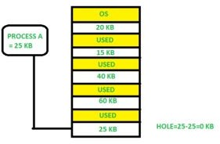
Best Fit
Allocate the smallest hole that is big enough.
We must search the entire list, unless the list is ordered by size.
This strategy produces the smallest leftover hole.
29-03-2021
18CSC205J Operating Systems- Memory Management

Slide 54
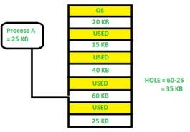
Worst Fit
Allocate the largest hole.
Again, we must search the entire list, unless it is sorted by size.
This strategy produces the largest leftover hole which may be useful for the other process
29-03-2021
18CSC205J Operating Systems- Memory Management

Slide 55
Problem to Solve
Question
Given five memory partitions of 100Kb, 500Kb, 200Kb, 300Kb, 600Kb (in order), how would the first-fit, best-fit, and worst-fit algorithms place processes of 212 Kb, 417 Kb, 112 Kb, and 426 Kb (in order)? Which algorithm makes the most efficient use of memory?
29-03-2021
18CSC205J Operating Systems- Memory Management

Slide 56
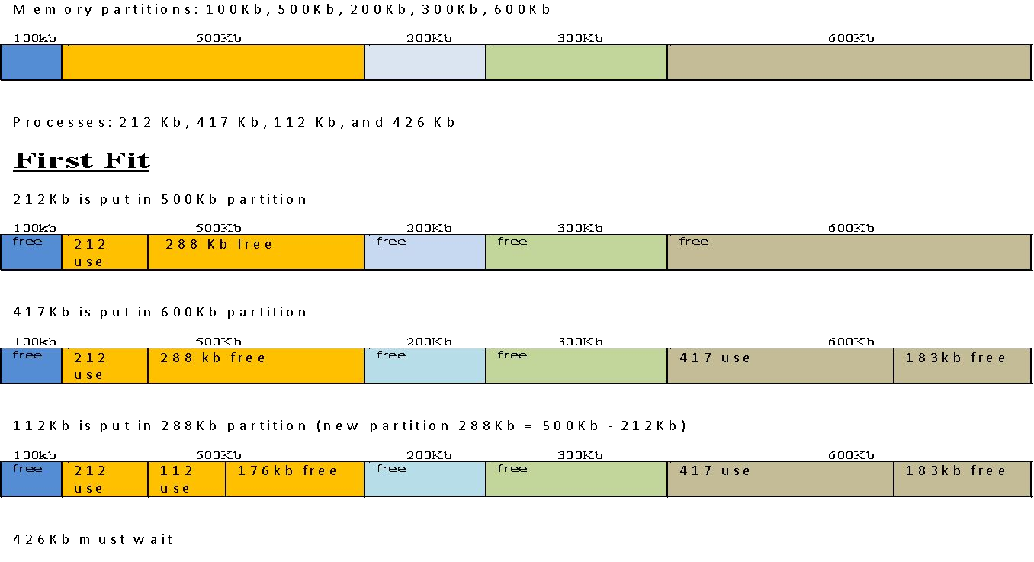
Steps to Solve – First Fit
29-03-2021
18CSC205J Operating Systems- Memory Management

Slide 57
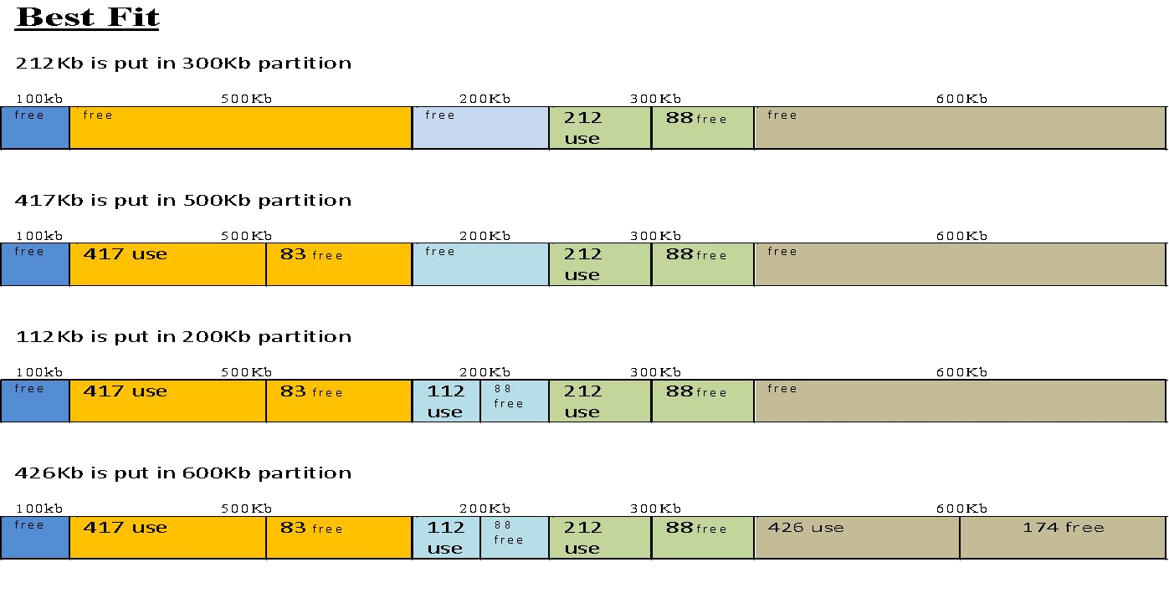
Steps to Solve – Best Fit
29-03-2021
18CSC205J Operating Systems- Memory Management

Slide 58
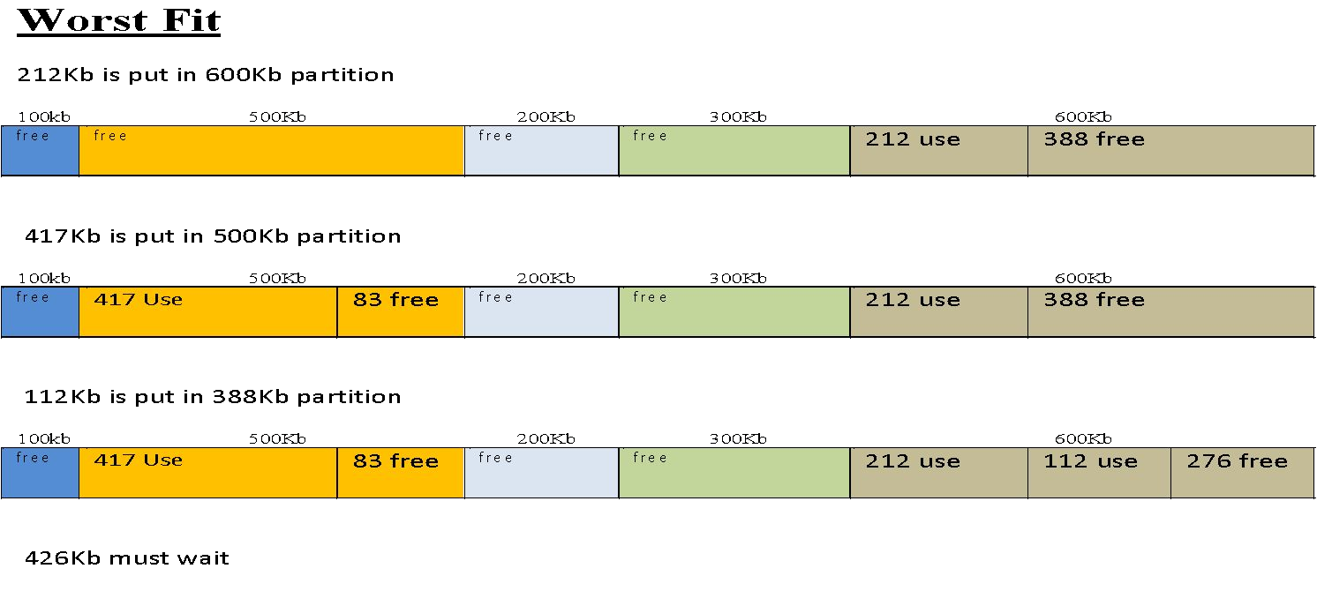
Steps to Solve – Worst Fit
29-03-2021
18CSC205J Operating Systems- Memory Management

Slide 59
Disadvantages of Variable - Partitioning
Complex Memory Allocation
External Fragmentation

Slide 60
Complex Memory Allocation
The task of allocation and deallocation is tough because the size of the partition varies whenever the partition is allocated to the new process. The operating system has to keep track of each of the partitions.
So, due to the difficulty of allocation and deallocation in the dynamic memory allocation, and every time we have to change the size of the partition; therefore, it is tough for the operating system to handle everything.

Slide 61
External Fragmentation
It occurs when the total amount of empty space required to store the process is available in the main memory.
But because the space is not contiguous, so the process can not be stored.
29-03-2021
18CSC205J Operating Systems- Memory Management

Slide 62
External Fragmentation (Cont.)
Consider, three processes P1 (1MB), P2 (3MB), and P3 (1MB), and we want to load the processes in the various partitions of the main memory.
Now the processes P1 and P3 are completed, and space that is assigned to the process P1 and P3 is freed. Now we have partitions of 1 MB each, which are unused and present in the main memory, but we cannot use this space to load the process of 2 MB in the memory because space is not contiguous.
The rule says that we can load the process into the memory only when it is contiguously residing in the main memory. So, if we want to avoid external fragmentation, then we have to change this rule.
29-03-2021
18CSC205J Operating Systems- Memory Management

Slide 63
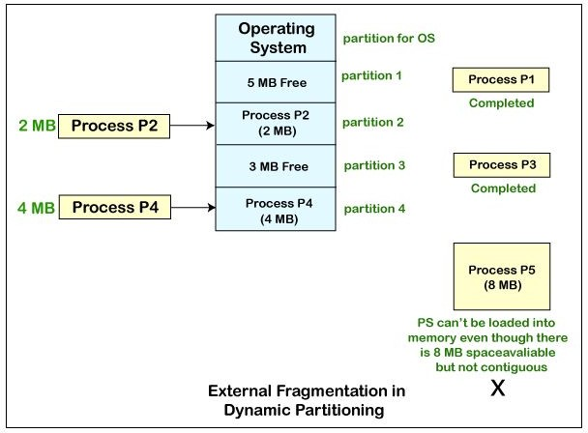
External Fragmentation (Cont.)
Example
29-03-2021
18CSC205J Operating Systems- Memory Management

Slide 64
Solution to External Fragmentation
This problem is occurring because we are allocating memory continuously to the processes. So, if we remove this condition external fragmentation can be reduced.
One of the way to remove external fragmentation is compaction. When dynamic partitioning is used for memory allocation then external fragmentation can be reduced by merging all the free memory together in one large block.
29-03-2021
18CSC205J Operating Systems- Memory Management

Slide 65
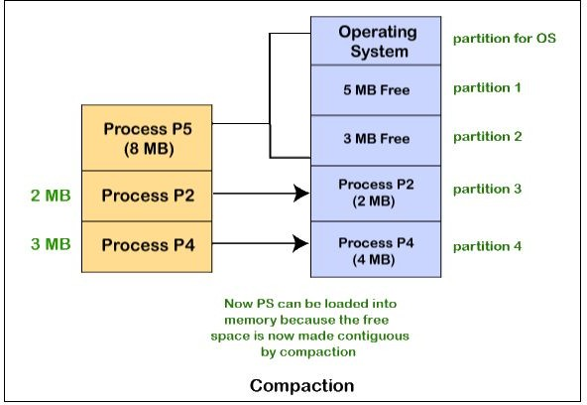
Solution to External Fragmentation (Cont.)
29-03-2021
18CSC205J Operating Systems- Memory Management

Slide 66
Solution to External Fragmentation (Cont.)
This technique is also called defragmentation. This larger block of memory is then used for allocating space according to the needs of the new processes.
Problem with Compaction
Due to compaction, the system efficiency is decreased because we need to move all the free spaces from one place to other.
In this way, the more amount of time is wasted, and the CPU remains ideal all the time. Instead of that, with the help of compaction, we can avoid external fragmentation, but this will make the system inefficient.
29-03-2021
18CSC205J Operating Systems- Memory Management

Slide 67
Solution to External Fragmentation (Cont.)
Another way, paging & segmentation (non-contiguous memory allocation techniques) where memory is allocated non-contiguously to the processes.
29-03-2021
18CSC205J Operating Systems- Memory Management

Slide 68
Fixed vs Variable Partitioning
S.NO.
Fixed partitioning Variable partitioning
In multi-programming with fixed partitioning the main memory is divided into fixed sized partitions.
In multi-programming with variable partitioning the main memory is not divided into fixed sized partitions.
1.
2.
Only one process can be placed in a partition.
In variable partitioning, the process is allocated a chunk of free memory.
3.
It does not utilize the main memory effectively.
It utilizes the main memory effectively.
4.
There is presence of internal fragmentation and external fragmentation.
There is external fragmentation.
5.
Degree of multi-programming is less.
Degree of multi-programming is higher.
6.
It is more easier to implement.
It is less easier to implement.
7.
There is limitation on size of process.
There is no limitation on size of process.
29-03-2021
18CSC205J Operating Systems- Memory Management

Slide 69
Internal vs External Fragmentation
INTERNAL FRAGMENTATION | EXTERNAL FRAGMENTATION
Memory allocated to a process may be slightly larger than the requested memory. The difference between these two numbers is internal fragmentation. | External fragmentation exists when there is enough total memory space to satisfy a request but available spaces are not contiguous.
First-fit and best-fit memory allocation does not suffer from internal fragmentation. | First-fit and best-fit memory allocation suffers from external fragmentation.
Systems with fixed-sized allocation units, such as the single partitions scheme and paging suffer from internal fragmentation. | Systems with variable-sized allocation units, such as the multiple partitions scheme and segmentation suffer from external fragmentation.
29-03-2021
18CSC205J Operating Systems- Memory Management

Slide 70
Non Contiguous Allocation
Non-contiguous memory allocation is a memory allocation technique.
It allows to store parts of a single process in a non-contiguous fashion.
Thus, different parts of the same process can be stored at different places in the main memory.
29-03-2021
18CSC205J Operating Systems- Memory Management

Slide 71
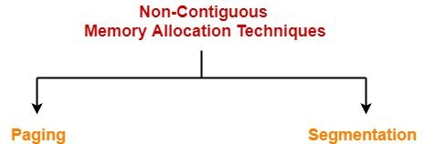
Techniques
29-03-2021
18CSC205J Operating Systems- Memory Management

Slide 72
PAGING

Slide 73
Paging
Paging is a memory management scheme that eliminates the need for contiguous allocation of physical memory.
Paging permits the physical address space of a process to be non – contiguous.
The mapping from virtual to physical address is done by the memory management unit (MMU) which is a hardware device and this mapping is known as paging technique.
29-03-2021
18CSC205J Operating Systems- Memory Management

Slide 74
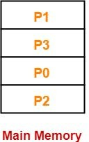
Example
Consider a process is divided into 4 pages P₀, P₁, P₂ and P₃.
29-03-2021
18CSC205J Operating Systems- Memory Management

Slide 75
In the above example, the process P is divided into 4 sections namely P0, P1, P2, P3.
All the four sections are mapped in the main memory in a non – contiguous fashion.

Slide 76
Paging
In the paging mechanism two addresses are involved
Logical Address
CPU always generates a logical address.
Physical Address
A physical address is needed to access the main memory.
29-03-2021
18CSC205J Operating Systems- Memory Management

Slide 77
Logical Address and Physical Address
Logical Address or Virtual Address :
An address generated by the CPU
Logical Address Space or Virtual Address Space:
The set of all logical addresses generated by a program
Physical Address:
An address actually available on memory unit
Physical Address Space :
The set of all physical addresses corresponding to the logical addresses
29-03-2021
18CSC205J Operating Systems- Memory Management

Slide 78
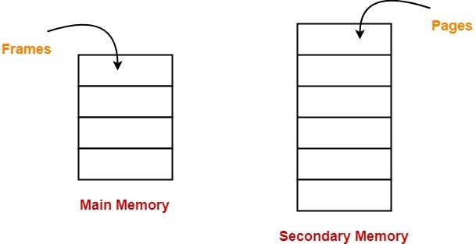
The Physical Address Space is conceptually divided into a number of fixed-size blocks, called frames.
The Logical address called pages.
Page Size = Frame Size
Space is also divided into fixed-size blocks,
29-03-2021
18CSC205J Operating Systems- Memory Management

Slide 79
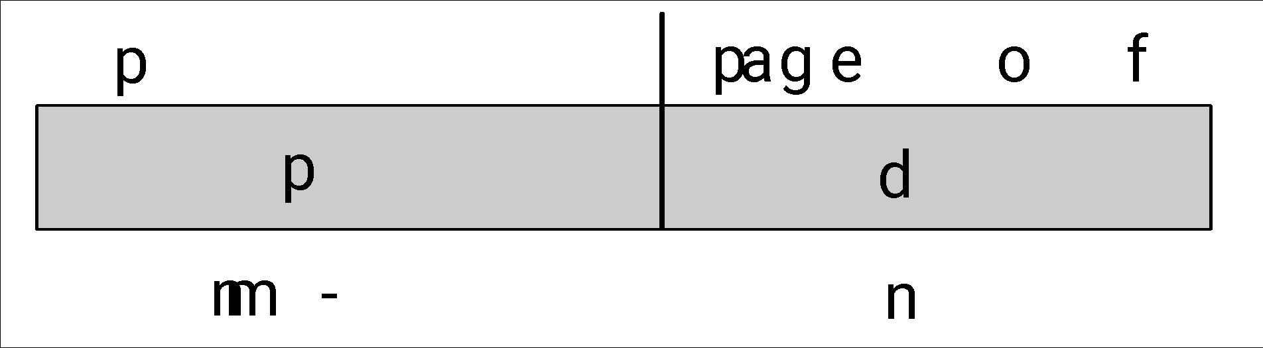
Logical Address
Address generated by CPU is divided into:
Page number (p) – used as an index into a page table which contains base address of each page in physical memory
Page offset (d) – combined with base address to define the physical memory address that is sent to the memory unit
For given logical address space 2^{m} and page size 2^{n}
29-03-2021
18CSC205J Operating Systems- Memory Management

Slide 80
Physical Address
Physical Address is divided into
Frame number(f): Number of bits required to represent the frame of Physical Address Space or Frame number.
Frame offset(d): Number of bits required to represent particular word in a frame or frame size of Physical Address Space or word number of a frame or frame offset.
29-03-2021
18CSC205J Operating Systems- Memory Management

Slide 81
If Logical Address = 31 bit, then Logical Address Space = 2³¹ words = 2 G words (1 G = 2³⁰)
If Logical Address Space = 128 M words = 2⁷ * 2²⁰ words, then Logical
Address = log 2²⁷ = 27 bits
2
If Physical Address = 22 bit, then Physical Address Space = 2²² words = 4 M words (1 M = 2²⁰)
If Physical Address Space = 16 M words = 2⁴ * 2²⁰ words, then Physical
Address = log 2²⁴ = 24 bits
2
29-03-2021
18CSC205J Operating Systems- Memory Management

Slide 82
Memory Management
The Mapping between these two address is done to execute the process using the paging technique.
The Hardware device that at run time maps virtual address to physical address is done by the Memory Management Unit (MMU)
29-03-2021
18CSC205J Operating Systems- Memory Management

Slide 83
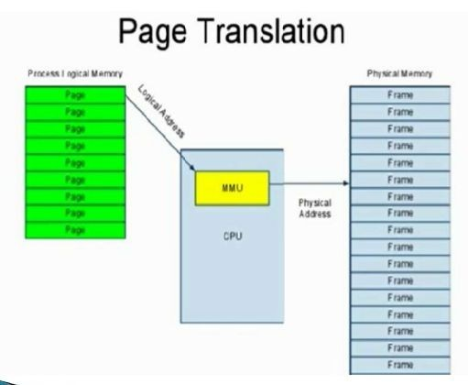
29-03-2021
18CSC205J Operating Systems- Memory Management

Slide 84
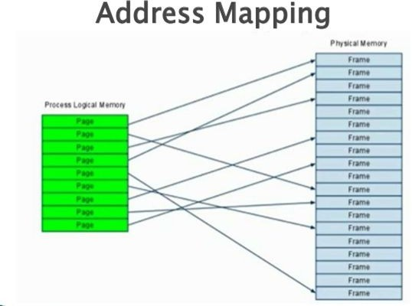
29-03-2021
18CSC205J Operating Systems- Memory Management

Slide 85
Paging Hardware
How does system perform translation? Simplest solution: use a page table.
Page table is a linear array indexed by virtual page number that gives the physical page frame that contains that page through the look up process.

Slide 86
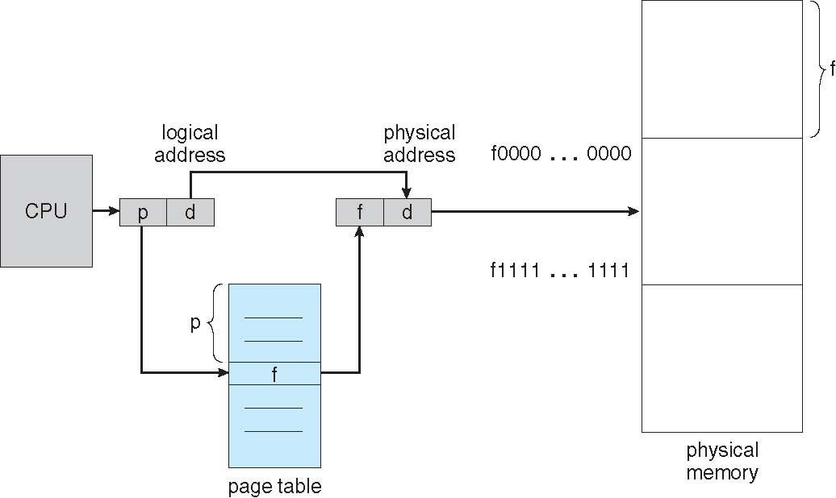
Paging Hardware
29-03-2021
18CSC205J Operating Systems- Memory Management
86

Slide 87
Paging Hardware
LOOK UP PROCESS
Step 1 :Extract page number. Step 2 : Extract offset.
Step 3 : Check that page number is within address space of process. Step 4 : Look up page number in page table.
Step 5 : Add offset to resulting physical frame number Step 6 : Access memory location.

Slide 88
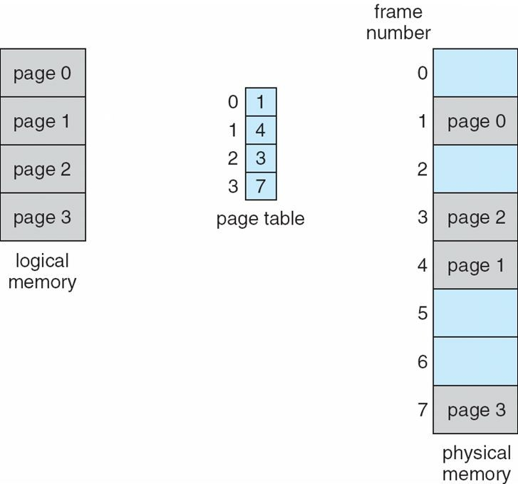
Paging Model of Logical and Physical Memory
29-03-2021
18CSC205J Operating Systems- Memory Management
88

Slide 89
In the example a process is divided into four pages as page0, page1, page 2 and page3.
All the four pages are mapped to the frames in the physical memory through the page table.
The page table maps the page number to its corresponding frame number in the physical memory.
page0 is mapped to frame1 , page1 is mapped to frame 4, page2 is mapped to frame 3 and page4 is mapped to frame 7.

Slide 90
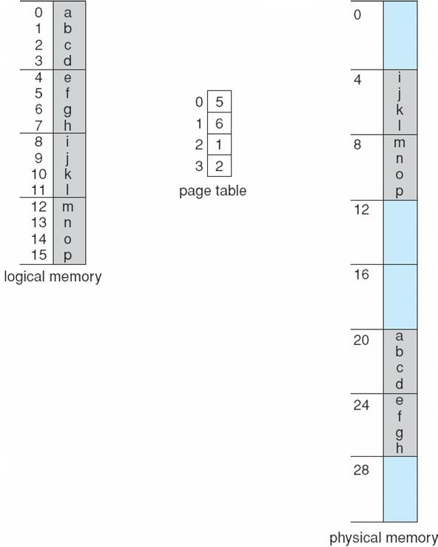
Paging Example
29-03-2021
18CSC205J Operating Systems- Memory Management

Slide 91
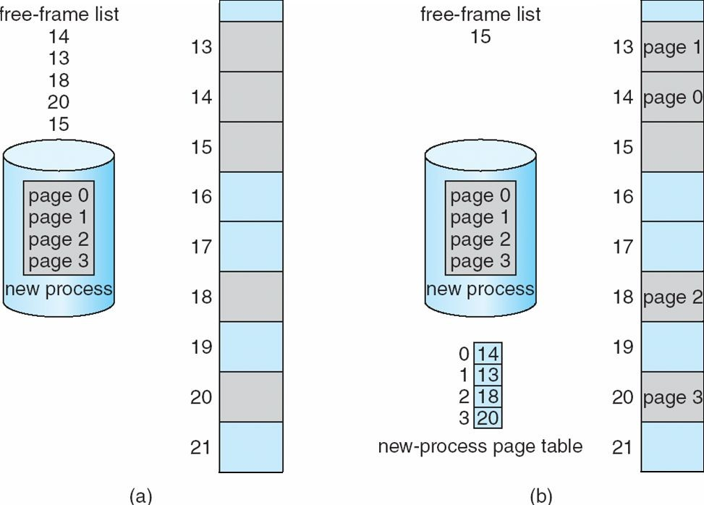
Free Frame List
29-03-2021
18CSC205J Operating Systems- Memory Management

Slide 92
Free Frame List
The example
Fig (a) shows a process divided into available in the physical memory.
4 pages and the list of free frames
Fig(b) shows the mapping of these pages to the free frames available and the updated list of free frames available in the physical memory.

Slide 93
Page Table
Page table is kept in main memory
Page-table base register (PTBR) points to the page table
Page-table length register (PTLR) indicates size of the page table
29-03-2021
18CSC205J Operating Systems- Memory Management

Slide 94
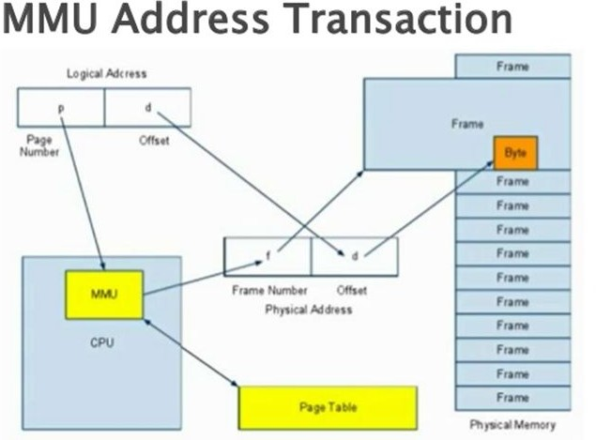
29-03-2021
18CSC205J Operating Systems- Memory Management

Slide 95
Problem with paging
In this scheme every data/instruction access requires two memory accesses
One for the page table and one for the data / instruction
The two memory access problem can be solved by the use of a special fast-lookup hardware cache called associative memory or translation look-aside buffers (TLBs)
29-03-2021
18CSC205J Operating Systems- Memory Management

Slide 96
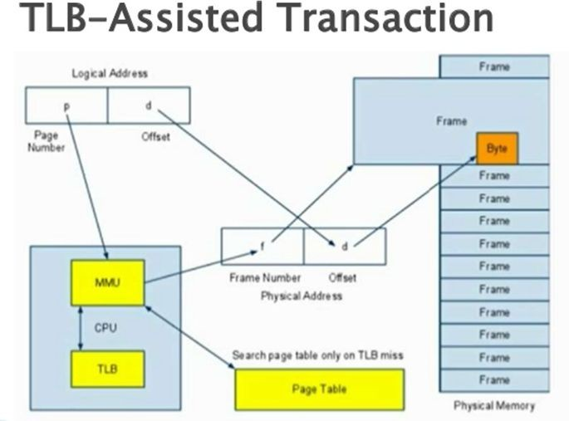
29-03-2021
18CSC205J Operating Systems- Memory Management

Slide 97
Translation Lookaside Buffer (TLB)
Speed up the lookup problem with a cache. Store most recent page lookup values in TLB.
Procedure of TLB
Step 1 :Extract page number. Step 2 : Extract offset.
Step 3 : Look up page number in TLB.
Step 4 : If there, add offset to physical page number and access memory location.
Step 5 : Otherwise, trap to OS. OS performs check, looks up physical page number, and loads translation into TLB. Restarts the instruction.

Slide 98
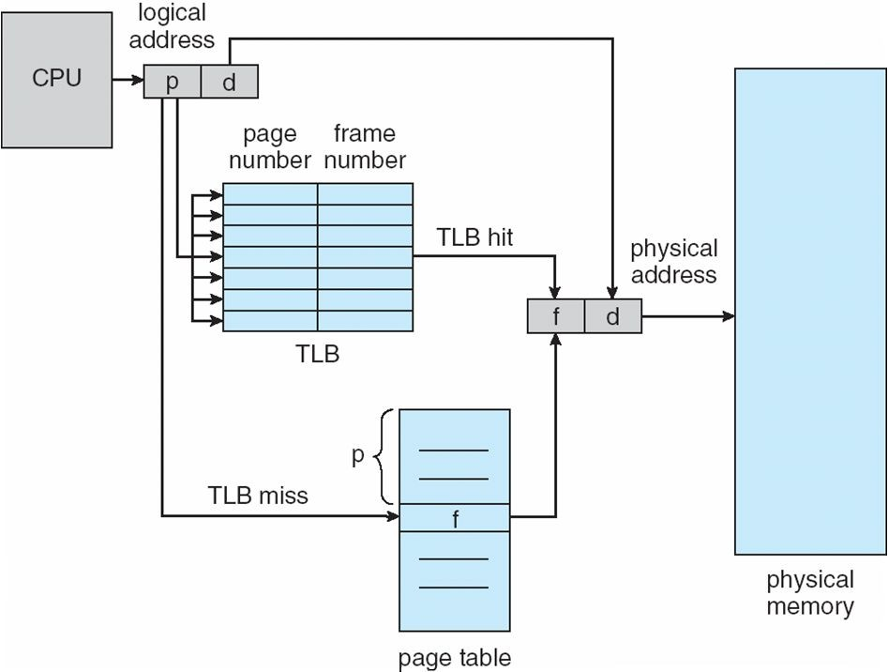
Paging with TLB
29-03-2021
18CSC205J Operating Systems- Memory Management

Slide 99
If the page number is not in the TLB (TLB miss) a memory reference to the page table must be made.
In addition, we add the page number and frame number into TLB
If the TLB already full, the OS have to must select one for replacement
Some TLBs allow entries to be wire down, meaning that they cannot be removed from the TLB, for example kernel codes
The percentage of times that a particular page number is found in the TLN is called hit ratio
29-03-2021
18CSC205J Operating Systems- Memory Management

Slide 100
Fixed size allocation of physical memory in page frames dramatically simplifies allocation algorithm.
OS can just keep track of free and used pages and allocate free pages when a process needs memory.
There is no fragmentation of physical memory into smaller and smaller allocatable chunks.

Slide 101
Effective Access Time
Associative Lookup = ε time unit
Can be < 10% of memory access time
Hit ratio = α
Hit ratio – percentage of times that a page number is found in the associative registers; ratio related to number of associative registers
Consider α = 80%, ε = 20ns for TLB search, 100ns for memory access
Effective Access Time (EAT) EAT = (1 + ε) α + (2 + ε)(1 – α)
= 2 + ε – α
Consider α = 80%, ε = 20ns for TLB search, 100ns for memory access
EAT = 0.80 x 100 + 0.20 x 200 = 120ns
29-03-2021
18CSC205J Operating Systems- Memory Management
101

Slide 102
Memory Protection
The process has to be protected for the following reasons:
Preventing one process from reading or writing another process' memory.
Preventing one process from reading another process' memory.
Preventing a process from reading or writing some of its own memory.
Preventing a process from reading some of its own memory.

Slide 103
Memory Protection
Memory protection is implemented by associating protection bit with each frame to indicate if read-only or read-write access is allowed
Can also add more bits to indicate page execute-only, and so on
Valid-invalid bit attached to each entry in the page table:
“valid” indicates that the associated page is in the process’ logical address space, and is thus a legal page
“invalid” indicates that the page is not in the process’ logical address space
Or use page-table length register (PTLR)
Any violations result in a trap to the kernel
29-03-2021
18CSC205J Operating Systems- Memory Management
103

Slide 104
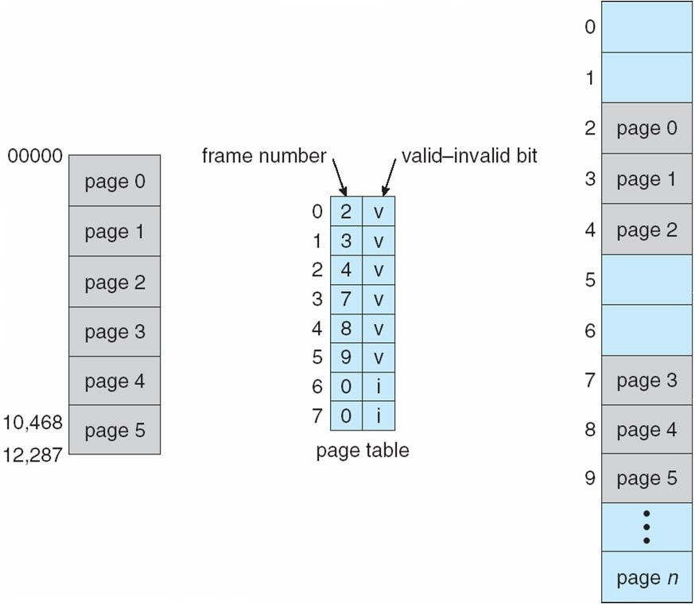
Valid – Invalid Bit
29-03-2021
18CSC205J Operating Systems- Memory Management
103

Slide 105
Pages that are not loaded into memory are marked as invalid in the page table, using the invalid bit.
In the above example Page0 to page5 is present in the memory .so , the corresponding valid/Invalid bit is marked as V(Valid).
The other pages which are not loaded such as page6 and page7 are marked as I(Invalid)

Slide 106
PageFault
if a page is needed that was not originally loaded up, then a page fault trap is generated
Page fault is handled by the following steps:
Step 1: The memory address requested is first checked, to make sure it was a valid memory request.
Step 2: If the reference was invalid, the process is terminated.
Otherwise, the page must be paged in.
Step 3: A free frame is located, possibly from a free-frame list.

Slide 107
Step 4: A disk operation is scheduled to bring in the necessary page from disk.
Step 5: When the I/O operation is complete, the process's page table is updated with the new frame number, and the invalid bit is changed to indicate that this is now a valid page reference.
Step 6: The instruction that caused the page fault must now be restarted from the beginning

Slide 108
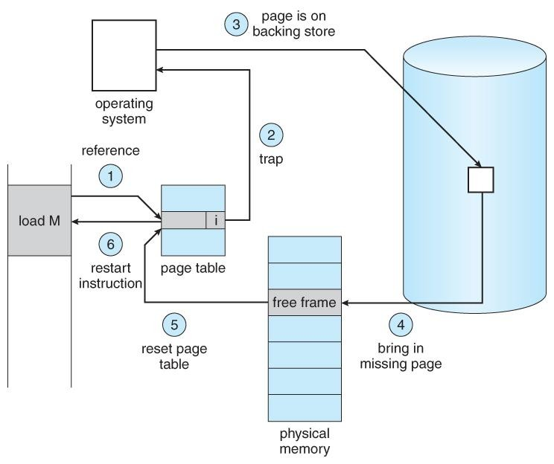

Slide 109
Shared Pages
Shared code
One copy of read-only (reentrant) code shared among processes (i.e., text editors, compilers, window systems)
Similar to multiple threads sharing the same process space
Also useful for interprocess communication if sharing of read-write pages is allowed
Private code and data
Each process keeps a separate copy of the code and data
The pages for the private code and data can appear anywhere in the logical address space
29-03-2021
18CSC205J Operating Systems- Memory Management
109

Slide 110
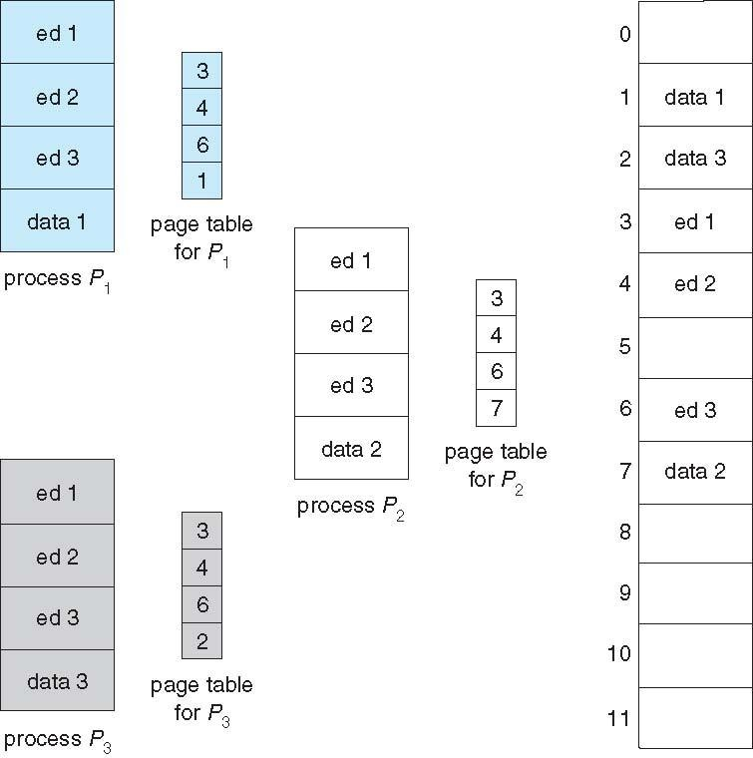
Shared Pages
29-03-2021
18CSC205J Operating Systems- Memory Management
109

Slide 111
Shared Pages
In the example figure, three pages ed1,ed2 and ed3 are shred by three processes Process1 , Process2, Process3.
The page is loaded only once and the corresponding frame number is updated in the page table of the three processes.

Slide 112
STRUCTURE OF A PAGE TABLE

Slide 113
Structure of the Page Table
Memory structures for paging can get huge using straight-forward methods
Consider a 32-bit logical address space as on modern computers
Page size of 4 KB (2¹²)
Page table would have 1 million entries (2³² / 2¹²)
If each entry is 4 bytes -> 4 MB of physical address space / memory for page table alone
That amount of memory used to cost a lot
Don’t want to allocate that contiguously in main memory
Hierarchical Paging
Hashed Page Tables
Inverted Page Tables

Slide 114
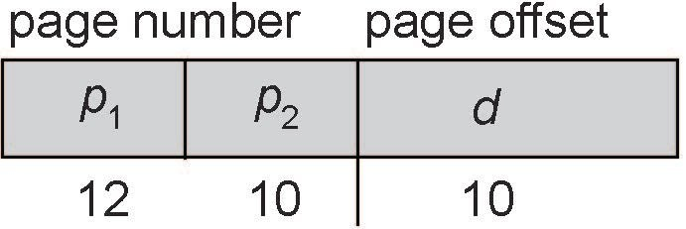
Two-Level Paging Example
Simple solution to this problem is to divide the page table into smaller pieces We can accomplish this division in several ways
A logical address (on 32-bit machine with 1K page size) is divided into:
a page number consisting of 22 bits
a page offset consisting of 10 bits
Since the page table is paged, the page number is further divided into:
a 12-bit page number
a 10-bit page offset
Thus, a logical address is as follows:
where p₁ is an index into the outer page table, and p₂ is the displacement within the page of the inner page table

Slide 115
Hierarchical Page Tables
Break up the logical address space into multiple page tables
A simple technique is a two-level page table
We then page the page table

Slide 116
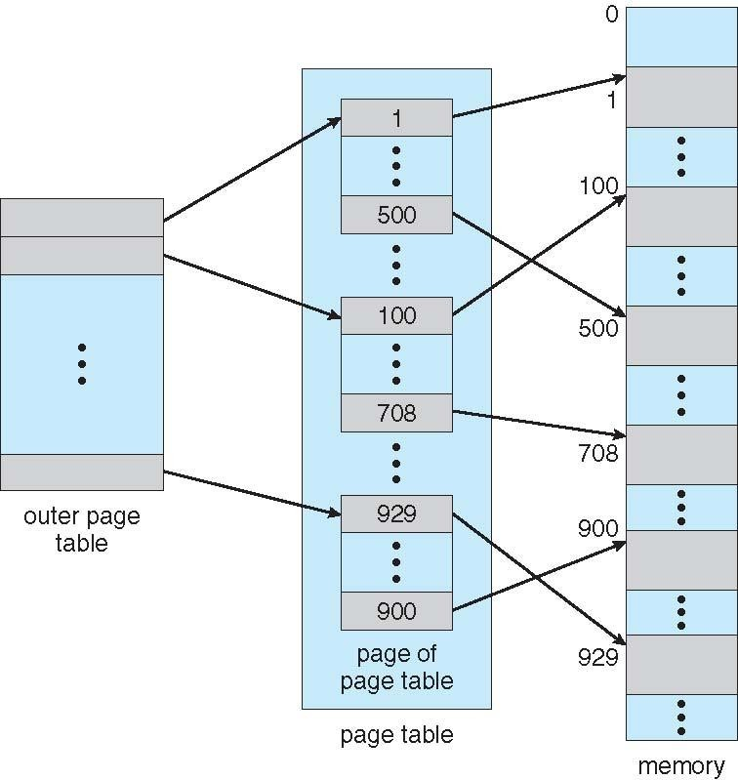
Two-Level Page-Table Scheme

Slide 117
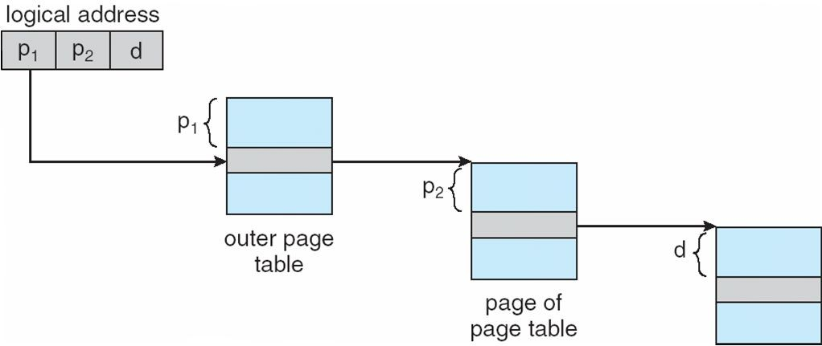
Address-Translation Scheme
for two level 32 bit paging architecture

Slide 118
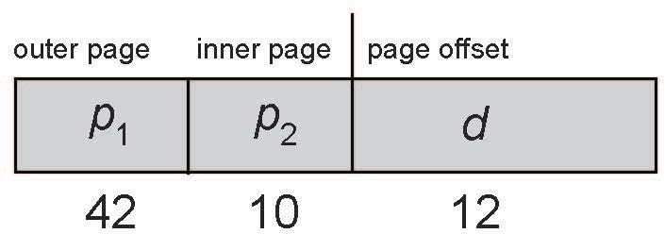
64-bit Logical Address Space
For a system with a 64-bit logical address space, a two-level paging scheme is no longer appropriate
If page size is 4 KB (2¹²)
Then page table has 2⁵² entries
If two level scheme, inner page tables could be 2¹⁰ 4-byte entries
Address would look like
Outer page table has 2⁴² entries or 2⁴⁴ bytes
One solution is to add a 2nd outer page table
But in the following example the 2nd outer page table is still 2³⁴ bytes in size
And possibly 4 memory access to get to one physical memory location

Slide 119
We can divide the outer page table in various ways. For example, we can page the outer page table, giving us a three-level paging scheme. Suppose that the outer page table is made up of standard-size pages (210 entries, or 212 bytes). In this case, a 64-bit address space is still daunting
This keeps growing that is the reason hierarchical page tables are generally considered inappropriate

Slide 120
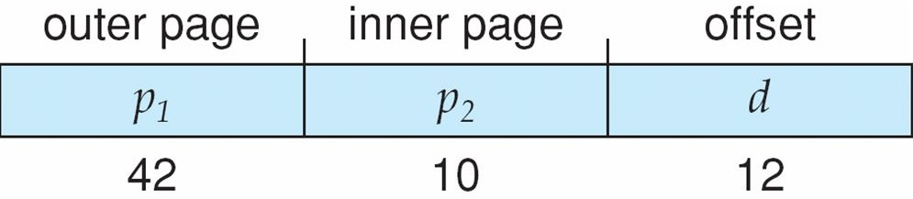
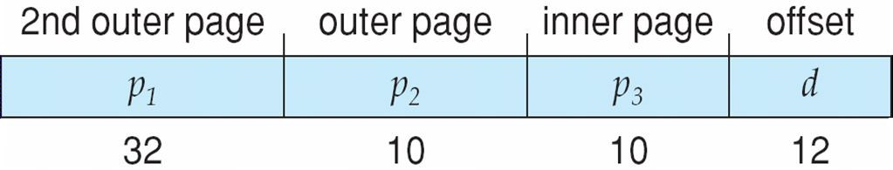
Three-level Paging Scheme

Slide 121
Hashed Page Tables
One approach for handling address spaces larger than 32 bits is to use a hashed page table, with the hash value being the virtual page number
Common in address spaces > 32 bits
The virtual page number is hashed into a page table
This page table contains a chain of elements hashing to the same location
Each element contains (1) the virtual page number (2) the value of the mapped page frame (3) a pointer to the next element

Slide 122
Hashed Page Tables (Cont.)
Virtual page numbers are compared in this chain searching for a match
If a match is found, the corresponding physical frame is extracted
Variation for 64-bit addresses is clustered page tables
Similar to hashed but each entry refers to several pages (such as 16) rather than 1
Especially useful for sparse address spaces (where memory references are non-contiguous and scattered)

Slide 123
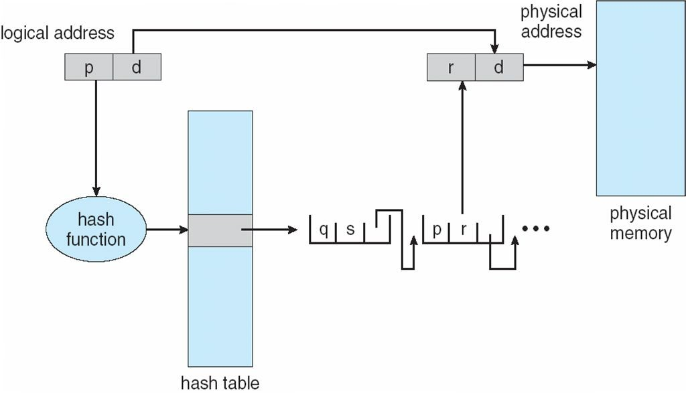
Hashed Page Table

Slide 124
Inverted Page Table
Rather than each process having a page table and keeping track of all possible logical pages, track all physical pages
One entry for each real page of memory
Entry consists of the virtual address of the page stored in that real memory location, with information about the process that owns that page

Slide 125

Inverted Page Table Architecture

Slide 126
Paging - ARM
The paging scheme used by ARM processors uses a 2 level page table.
The first level page table has 16kB size and each entry covers a region of 1MB (sections).
The second level page tables have 1kB size and each entry covers a region of 4KB (pages).
The TLB also supports 16MB sections and 64kB pages

Slide 127
Paging - ARM
On ARMv4 and ARMv5 pages might also be divided into what the manual calls 'subpages‘
Example : for a 4KB page, 1KB subpages, and for a 64KB page, 16KB subpages.
The ARM processor supports 2 independent page tables.
The first page table can be abbreviated from the full 16kB
The second page table is always 16KB in size and is used for addresses beyond the end of the first page table.

Slide 128


Slide 129
SEGMENTATION

Slide 130
Non-Contiguous Memory Allocation
Segmentation
29-03-2021
18CSC205J Operating Systems- Memory Management
130

Slide 131
Segmentation
Memory-management scheme that supports user view of memory.
Segmentation overcomes the problem of dealing with memory in terms of its physical properties which is inconvenient to both the operating system and the programmer.
The system have more freedom to manage memory.
The programmer would get an experience to programming environment.
work in more natural

Slide 132
Program and Segment
A program is a collection of segments in which unit which consists of the following :
main program
procedure
Function
Method
Object
local variables, global variables
common block
Stack
symbol table
arrays
segment is a logical
29-03-2021
18CSC205J Operating Systems- Memory Management
132

Slide 133

User’s View of a Program
Most programmers prefer to view memory as a collection of variable-sized segments with no necessary ordering among the segments.
From programmer point of view , a program will appear as a main program with a set of methods, procedures, or functions. Program also includes the following data structures:
Objects
Arrays
Stacks and
Variables
Modules or data elements is referred by name.
The programmer talks about “the stack,” “the math library,” and “the main program” without caring what addresses in memory these elements occupy.
Programmer is not concerned with whether the stack is stored before or after the Sqrt() function.

Slide 134
Logical View of Segmentation
In the figure, both user space and physical memory space are given.
1
4
2
3
Segments vary in length, and the length of each is intrinsically defined by its purpose in the program.
1
2
Segments are numbered as 1,2,3 and 4.
3
In Physical
memory space, Segments are
allocated in different parts of the memory
4
For example,
Elements within a segment are identified by their offset from the beginning of the segment: the first statement of the program, the seventh stack frame entry in the stack and the fifth instruction of the Sqrt()
user space
physical memory space

Slide 135
Example – Compilation of C program
Normally, when a program is compiled, the compiler automatically constructs segments reflecting the input program.
A “C” compiler might create separate segments for the following:
The code
Global variables
The heap, from which memory is allocated
The stacks used by each thread
The standard C library
Libraries that are linked in during compile time might be assigned separate segments.
The loader would take all these segments and assign them segment numbers.
29-03-2021
18CSC205J Operating Systems- Memory Management
135

Slide 136
Segmentation Architecture
Logical address consists of a two tuple:
<segment-number, offset>
A logical address consists of two parts: a segment number, s, and an offset into that segment, d.
The segment number is used as an index to the segment table.
The offset d of the logical address must be between 0 and the segment limit.
If it is not, a trap is sent to the operating system (logical addressing attempt beyond end of segment).
When an offset d is legal, it is added to the segment base to produce the address in physical memory of the desired byte.

Slide 137
Segmentation Architecture (Cont.)
Segment table – maps two-dimensional physical addresses; each table entry has:
base – contains the starting physical address where the segments reside in memory
limit – specifies the length of the segment
Segment-table base register (STBR) points to the segment table’s location in memory
Segment-table length register (STLR) indicates number of segments used by a program; segment number s is legal if s < STLR

Slide 138
Segmentation Architecture (Cont.)
Protection
With each entry in segment table associate:
validation bit = 0 ⇒ illegal segment
read/write/execute privileges
Protection bits associated with segments with code sharing occurs at segment level
Since segments varies in length, memory allocation is a dynamic

Slide 139

Segmentation Hardware

Slide 140

Segmentation Example
There are Five Segments numbered from 0 through 4.
The segments are stored in physical memory as shown in the diagram.
The segment table has a separate entry for each segment, giving the beginning address of the segment in physical memory (or base) and the length of that segment (or limit).
For example, segment 2 is 400 bytes long and begins at location 4300.
A reference to byte 53 of segment 2 is mapped onto location 4300 + 53 = 4353.
A reference to segment 3, byte 852, is mapped to 3200 (the base of segment 3) + 852 = 4052.
A reference to byte 1222 of segment 0 would result in a trap to the operating system, as this segment is only 1,000 bytes long.
29-03-2021 18CSC205J Operating Systems- Memory Management
140

Slide 141
Paged Segmentation
Paging + Segmentation
Takes advantage of both paging and segmentation
Implementation: Treat each segment independently. Each segment has a page table
Logical address now consists of 3 parts:
Segment number
Page number
Offset

Slide 142
Paged Segmentation Implementation
Segment table has base address for page table
Look up <page number, offset> in page table
Get physical address in return
Examples: MULTICS and Intel 386

Slide 143
Combined Paging and Segmentation Scheme
In a combined paging/segmentation system, a user’s address is broken up into a number of segments.
Each segment is broken up into a number of fixed-sized pages which are equal in length to the main memory frame

Slide 144

Address Translation

Slide 145
Advantages of Combined Scheme
Reduces memory usage as opposed to pure paging
Page table size limited by segment size
Segment table has only one entry per actual segment
Share individual pages by copying page table entries
Share whole segments by sharing segment table entries, which is the same as sharing the page table for that segment
Most advantages of paging still hold
Simplifies memory allocation
Eliminates external fragmentation
This system combines the efficiency in paging with protection and sharing capabilities of segmentation

Slide 146

Disadvantage
Internal fragmentation still exists

Slide 147
Example: The Intel 32 and 64-bit Architectures
Dominant industry chips
Pentium CPUs are 32-bit and called IA-32 architecture
Current Intel CPUs are 64-bit and called IA-64 architecture
Many variations in the chips, cover the main ideas here

Slide 148

Example: The Intel IA-32 Architecture
Memory management is divided as – Segmentation and Paging
CPU generates logical address
Selector given to segmentation unit
Which produces linear addresses
Linear address given to paging unit
Which generates physical address in main memory
Paging units form equivalent of MMU
Pages sizes can be 4 KB or 4 MB

Slide 149
The Intel IA-32 Segmentation
Supports both segmentation and paging
Each segment can be 4 GB
Up to 16 K segments per process
Divided into two partitions
First partition of up to 8 K segments are private to process (kept in local descriptor table (LDT))
Second partition of up to 8K segments shared among all processes (kept in global descriptor table (GDT))

Slide 150

Intel IA-32 Segmentation
The logical address is a pair (selector, offset), where the selector is a 16-bit number:
s designates segment number
g indicates if segment is GDT or LDT
p deals with protection
Offset is a 32-bit number and it specifies the location of the byte within segment

Slide 151

Intel IA-32 Segmentation

Slide 152
Intel IA-32 Segmentation
There are six segment registers – six segments can be addressed at a time
There are six 8-byte microprogram registers to hold LDT or GDT descriptors
Linear address is 32-bits long
Base and limit of segment is used to generate linear address
Limit is used to check address validity
Invalid address results in a trap
Value of base with offset results in 32-bit address

Slide 153

IA-32 Paging
Pages sizes of 4KB or 4MB is allowed in IA-32
4KB pages use two-level paging scheme
The 10 higher order bits reference the page directory – outermost page table
The innermost 10 bits refer the inner page table
Lower order 12 bits refer the offset in the page
1 bit in page directory is Page-Size flag
If set, indicates 4MB page rather than the default 4KB page

Slide 154

Intel IA-32 Paging Architecture

Slide 155
Intel IA-32 Page Address Extensions
32-bit address limits led Intel to create page address extension (PAE), allowing 32-bit apps access to more than 4GB of memory space
Paging went to a 3-level scheme
Top two bits refer to a page directory pointer table
Page-directory and page-table entries moved to 64-bits in size
Net effect is increasing address space to 36 bits – 64GB of physical memory
Linux and MAC support PAE
But, 32-bit versions of Windows desktop operating systems still provide support for only 4 GB of physical memory, even if PAE is enabled.

Slide 156

Intel IA-32 Page Address Extensions

Slide 157





Intel x86-64
Current generation Intel x86 architecture
Support for larger physical and logical address spaces
64 bit-systems can address 2⁶⁴ of addressable memory (16 exabytes)
In practice, only implement 48 bit addressing
Page sizes of 4 KB, 2 MB, 1 GB
Four levels of paging hierarchy
Can also use PAE so virtual addresses are 48 bits and physical addresses are 52 bits

Slide 158
Reference
Abraham Silberschatz, Peter Baer Galvin, Greg Gagne, Operating systems, 9th ed., John Wiley & Sons, 2013

